Slide 1

DATA MINING ON BANK MARKETING FOR TERM DEPOSITS
Arun Reddy
Vamshidar Reddy
Anirudh Myakala

Slide 2
OUTLINE
Introduction
Objective
Dataset
Models
Comparison of Results
Conclusion

Slide 3

INTRODUCTION
More interest rates than savings account.
The data is related with direct marketing campaigns of a Portuguese banking institution.
The marketing campaigns were based on phone calls.
The objective of the campaign is to persuade as many customers as possible to make a deposit.

Slide 4

OBJECTIVE
Using data mining build a model for the bank that provides target customers to the bank
Who are most likely make a term deposit and needed to be called.
Who will not make a term deposit and need not be called.

Slide 5
DATASET
Y
age
job
marital
education
default
Housing
loan
Contact
month
day_of_week
duration
campaign
pdays
previous
poutcome
emp.var.rate
cons.price.idx
cons.conf.idx
euribor3m
nr.employed
PREDICTORS : 20
TARGET VARIABLE :Y
(Whether Customer Will Make A Term Deposit Or Not)

Slide 6
MODELS
LOGISTIC REGRESSION
DECISION TREES

Slide 7
LOGISTIC REGRESSION
BEST PREDICTORS
Euribor3m
Contacttelephone
Defaultyes
jobstudent
campaign
emp.var.rate
CONFUSUSION MATRIX
obs
pred 0 1
0 1970 531
1 251 833
AccuMeasures
threshold 0.5
AUC 0.7248936
sensitivity 0.5227273
specificity 0.9270599
prop.correct 0.7732218

Slide 8
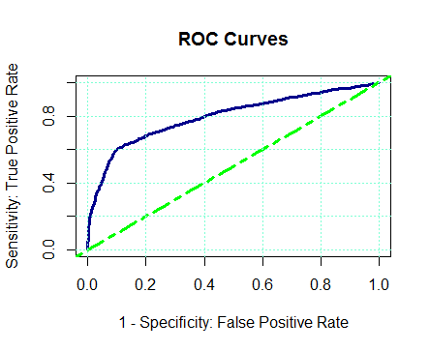
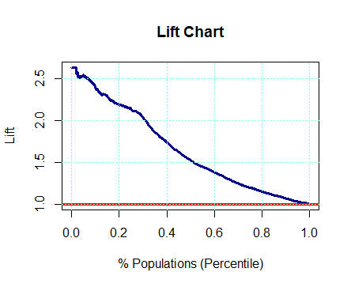
GAINS TABLE
Depth Cume Cume Pct Mean
of Cume Mean Mean of Total Lift Cume Model
File N N Resp Resp Resp Index Lift Score
-------------------------------------------------------------------------
10 358 358 0.91 0.91 23.9% 239 239 2.61
20 359 717 0.75 0.83 43.7% 198 218 1.25
30 360 1077 0.66 0.77 61.0% 172 203 0.47
40 357 1434 0.32 0.66 69.4% 85 174 -0.48
50 358 1792 0.26 0.58 76.2% 68 153 -0.91
60 359 2151 0.26 0.53 83.0% 67 138 -1.12
70 358 2509 0.16 0.47 87.2% 43 125 -1.28
80 359 2868 0.18 0.44 91.9% 47 115 -1.45
90 359 3227 0.17 0.41 96.3% 44 107 -1.65
100 358 3585 0.14 0.38 100.0% 37 100 -1.91

Slide 9
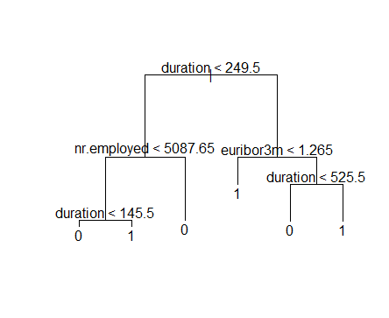
DECISION TRESS
DECISION TREE
CONFUSION MATRIX
tree0.pred No Yes
0 1994 309
1 227 1055
ACCURACY : 0.850

Slide 10
COMPARISION OF RESULTS
MODEL
LOGISTIC REGRESSION
DECISION TREES
ACCURACY
0.773
0.850

Slide 11
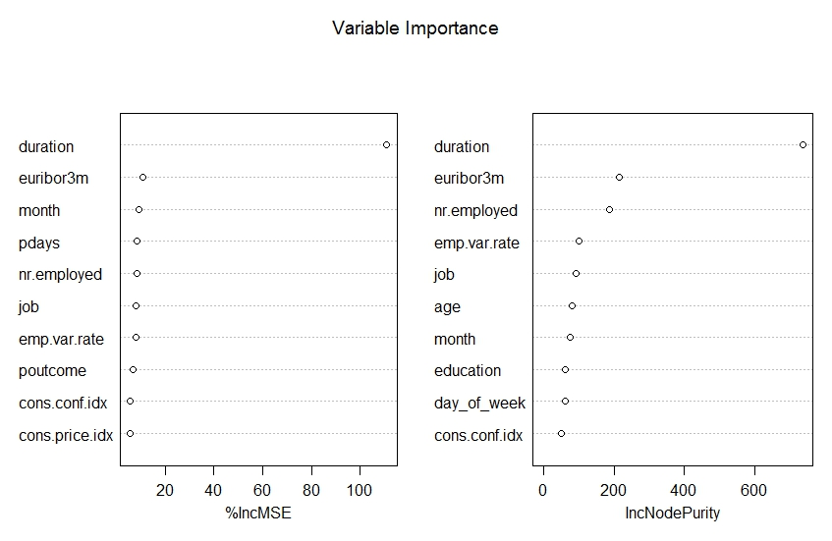
CONCLUSION
So ,Cleary we can say that Decision tree is the winner

Slide 12

THANK YOU

